Slide 1
cs414
principles of user interface design, implementation and evaluation

Slide 2
Heuristic Evaluation
Cognitive Walkthrough
Discuss Wednesday Homework
Discuss Projects

Slide 3
Heuristic evaluation is a usability inspection technique developed by Jakob Nielsen.
The original set of heuristics was derived empirically from an analysis of 249 usability problems (Nielsen, 1994). -Preece et al

Slide 4
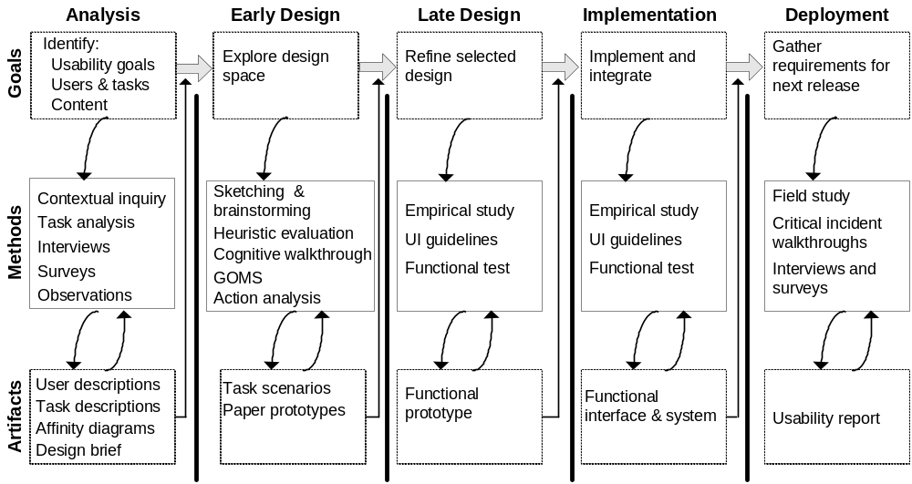
Context of TCUID - Task Centered User Interface Design

Slide 5
Validity of system status
- Are users kept informed about what is going on?
- Is appropriate feedback provided within reasonable time about a
user’s action?
Match between system and the real world
- Is the language used at the interface simple?
- Are the words, phrases and concepts used familiar to the user?
User control and freedom
- Are there ways of allowing users to easily escape from places
they unexpectedly find themselves in?
Consistency and standards
- Are the ways of performing similar actions consistent?
Help users recognize, diagnose, and recover from errors
- Are user messages helpful?
- Do they use plain language to describe the nature of the problem and
suggest a way of solving it?

Slide 6
Error prevention
- Is it easy to make errors?
- If so, where and why?
Recognition rather than recall
- Are objects, actions and options always visible?
Flexibility and efficiency of use
- Have accelerators (i.e. shortcuts) been provided that allow more
experience users to carry out tasks more quickly?
Aesthetic and minimalist design?
- Is any unnecessary and irrelevant information provided?
Help and documentation
- Is help information provided that can be easily searched and easily
followed?

Slide 7
These heuristics are too general in some cases
What about web pages? Ambient displays? Ubiquitous computing applications?
Strong need for heuristics that are tailored to specific products.
High quality content
Often updated
Minimal download time
Ease of use
Relevant to users’ needs
Unique to the online medium
Netcentric corporate culture - Nielsen 1999 for commercial websites

Slide 8
Heuristic evaluation enables designers to evaluate an interface without users
  inspection, guided by a set of guidelines
Economical technique to identify usability issues early in the design process
  no implementation or users required
  can be performed on existing interfaces

Slide 9
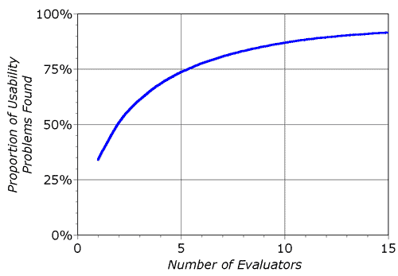
How many users?
Empirical evidence suggests that five evaluators usually identify around 75% of total usability problems.

Slide 10
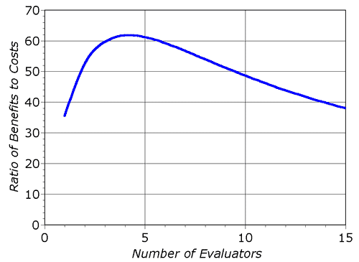

Slide 11
Helps identify usability problems in UI
  [Nielsen and Mohlich, 1990]
HE = heuristics + procedure
  about 5 evaluators
  each evaluates UI against heuristics
  rate severity of each issue
  aggregate results
  devise design solutions

Slide 12
Phases of Evaluation
Briefing
  teach to evaluators; ensure each person receives same briefing.
  become familiar with the UI and domain
Evaluation period
  compare UI against heuristics
  spend 1-2 hours with interface; minimal 2 interface passes
  take notes
Debriefing session
  Prioritize problems; rate severity
  aggregate results
  discuss outcomes with design/development team

Slide 13
Severity Ratings
0 – this is not a usability problem
1 – cosmetic problem only
2 – minor usability problem
3 – major usability problem
4 – usability catastrophe; imperative to fix
Combination of frequency and impact

Slide 14
Examples

Slide 15
Simple and Natural Dialog
Derive from user’s conceptual model
No irrelevant or rarely relevant info.
  “less is more” attitude
Order of dialog should match logical order of the task

Slide 16
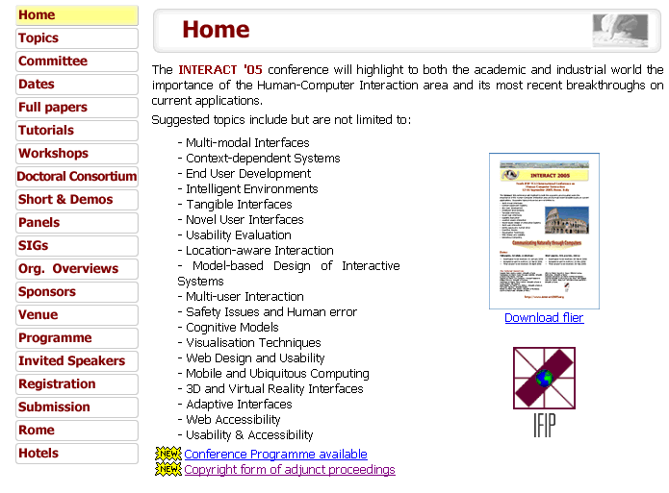
Does navigation reflect
logical order of tasks?
Is flier necessary on the home page?

Slide 17
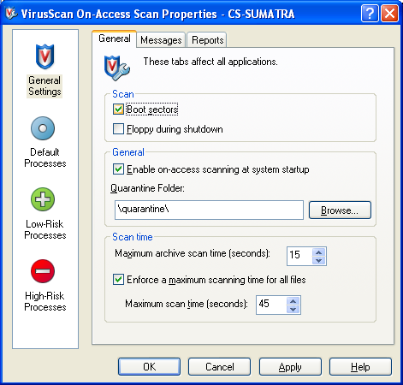
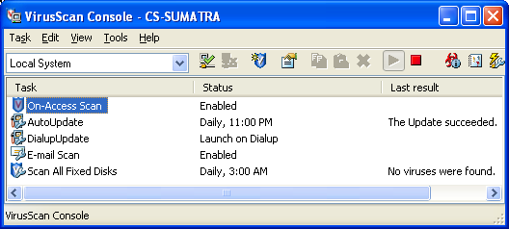
Task: Set scan properties
Effective order?
Simple dialog?
Natural dialog?

Slide 18
Speak the User’s Language
Words and concepts from user’s world
Don’t use specific engineering terms
Focus on user’s point of view

Slide 19
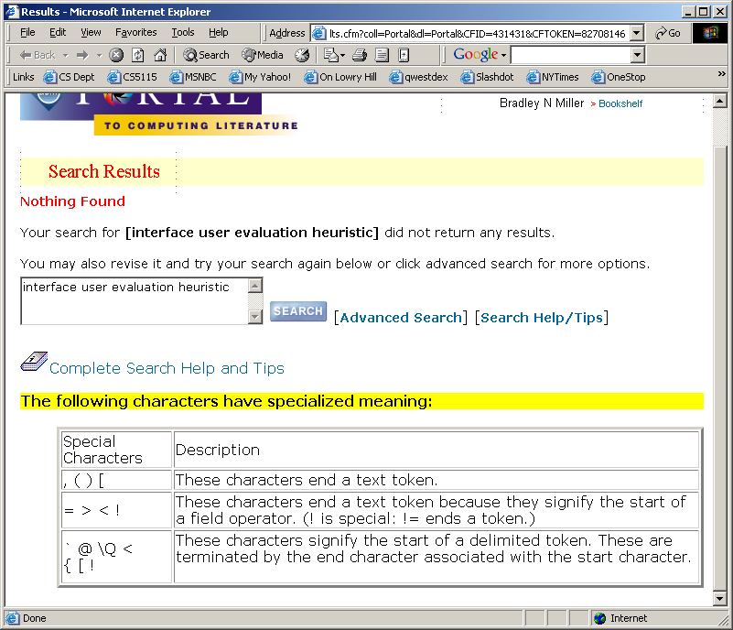

Slide 20
Minimize User Memory Load
Show range or sample inputs
Use generic actions across application
Don’t make user remember things between actions
Leave information on screen until not needed

Slide 21
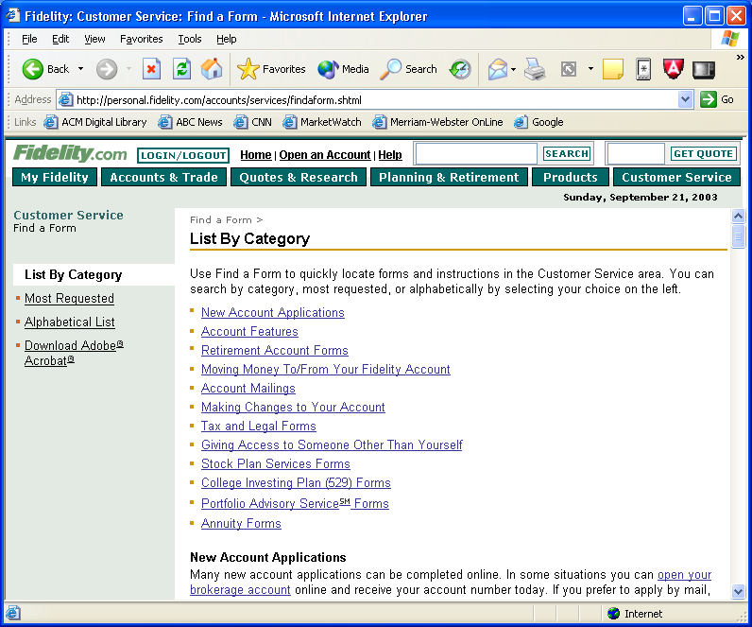

Slide 22
Be Consistent
Consistent with user’s mental model
Consistent with tasks
Consistent with experience/expectations
Consistent within and between apps
Similar information in similar locations
Use the same action sequence in different parts of the interface to get similar results

Slide 23
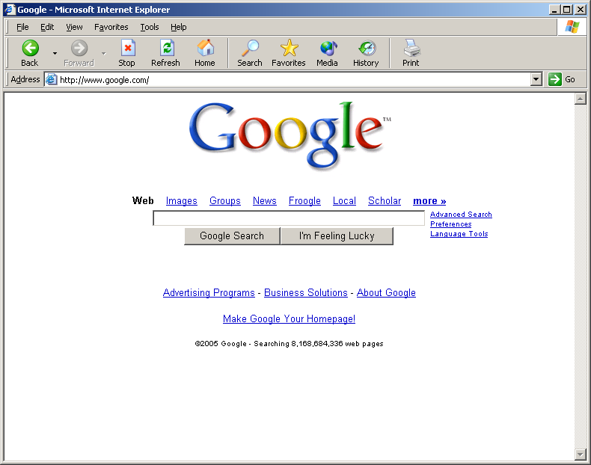

Slide 24
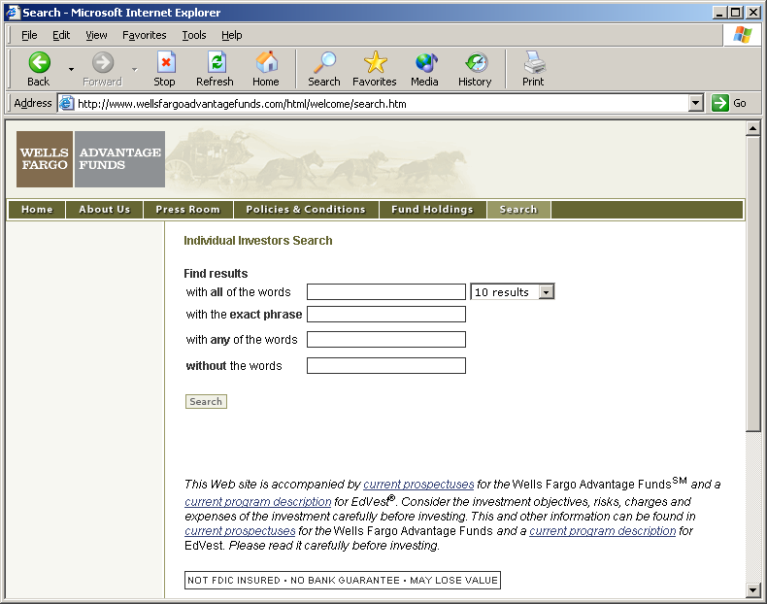

Slide 25
Provide Feedback
User should clearly see effects of action
  Obvious: do not hide or make results subtle
  Immediate: within a few seconds
  Valid: convey the right information
  Persistent: show as long as it is needed
  Speak the user’s language
Response times
  want less than 500 ms
  otherwise, use “reassurance” displays

Slide 26
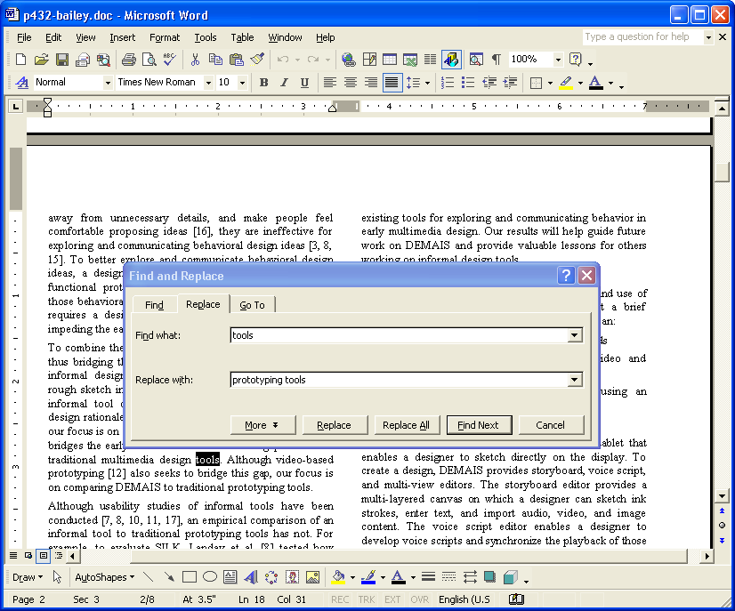
Dialog box moves
out of the way
But…
How many more
changes and where?

Slide 27
Provide Clearly Marked Exits
Don’t trap users in a certain location
Allow users to get back quickly and easily
  support exploration
  support undo consistently
  support interruption of long-lived events

Slide 28
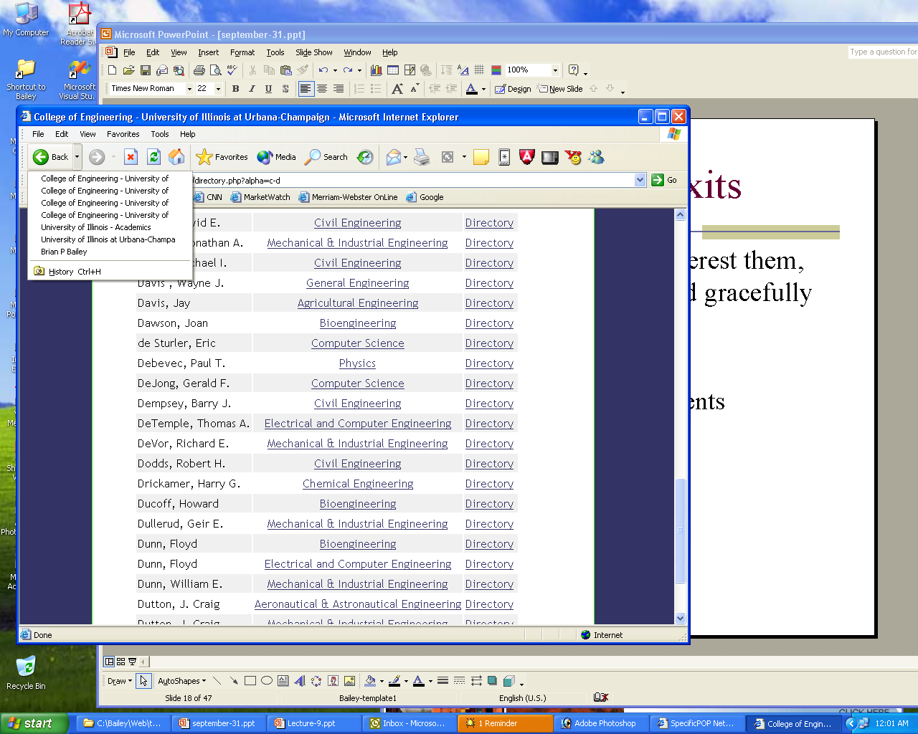

Slide 29
Provide Shortcuts
Help experienced users avoid long dialogs or messages that they don’t need
Strategies include:
  type- and click-ahead
  keyboard shortcuts
  good default values
  macros and scripting
  reuse/edit history

Slide 30
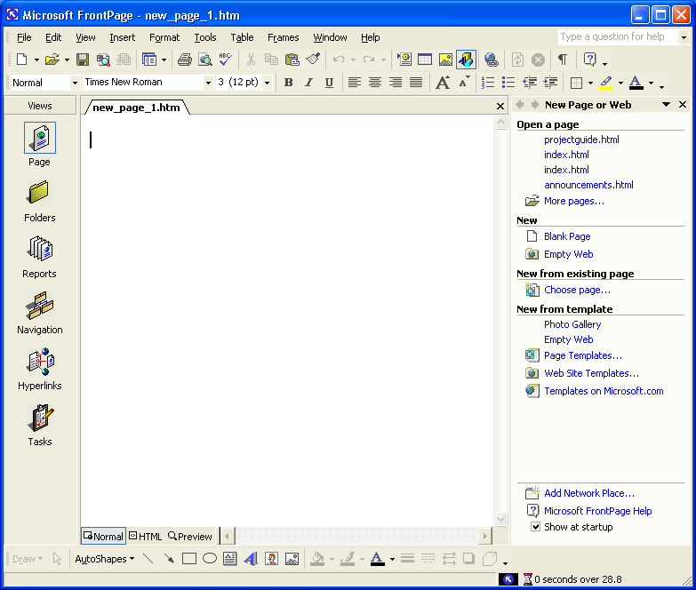

Slide 31
Provide Good Error Messages
Clear and in simple language
  user can dig deeper to get obscure details
State the problem / suggest solutions
  give links to the solutions, if possible
Use a positive, non-accusatory tone
Graceful error behavior

Slide 32
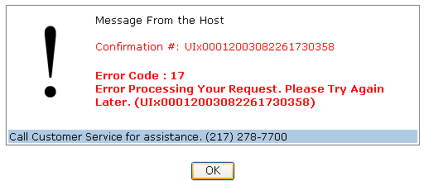
UIECU - server error
Negative tone
Useless error codes

Slide 33
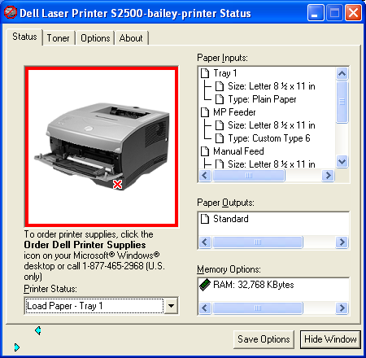
Printer error - what’s wrong?

Slide 34
Prevent Errors
Scrutinize every error message
Can the error be prevented?
  allow recognition over recall when possible
  confirm risky operations
  avoid use of modes as much as possible
  use clear status indicators
Detect when error occurs
Allow user to recover from the error

Slide 35
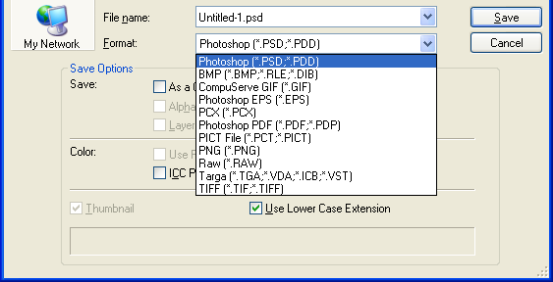
What happened to JPEG?

Slide 36
Help and Documentation
Best if system can be used w/o manuals
  but may not be possible
Documentation should be
  easy to search
  focused on the user's task
  list concrete steps to be carried out

Slide 37
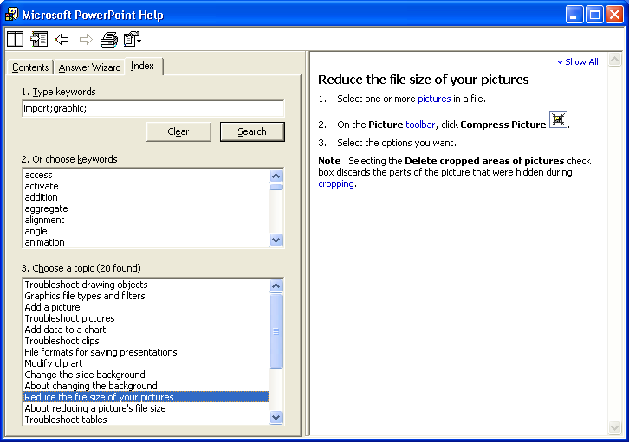

Slide 38
HE – Pros and Cons
Pros
  Very cost effective
  Identifies many usability issues
Cons
  relies on interpretation of guidelines
  guidelines may be too generic
  needs more than one evaluator to be effective

Slide 39
Cognitive walkthrough involve simulating a user’s problem-solving process at each step in the human-computer dialog, checking to see if the user’s goals and memory for actions can be assumed to lead to the next correct action. –Nielsen and Mack, 1994

Slide 40
Why we use it
Cognitive walkthrough enables a designer to evaluate an interface without users
  a designer attempts to see the interface from the perspective of a user
Low-investment technique to identify task-related usability issues early on
  no implementation or users required
  can be performed on existing interfaces

Slide 41
Identify task-related problems before implementation
  invest a little now, save a lot later
Enables rapid iteration early in design
  can do several evaluations of trouble points
Evaluations are only effective if your team
  has the right skill set
  wants to improve the design, not defend it

Slide 42
Walkthrough Basics
Imagine how well a user could perform tasks with your low-fidelity prototype
Manipulate prototype as you go
  evaluate choice-points in the interface
  evaluate labels or options
  evaluate likely user navigation errors
Revise prototype and perform again

Slide 43
When to do the Walkthrough
Have a low-fidelity prototype of the interface
Know who the users are
Have task descriptions
Have scenarios designed to complete the task
  you have a “functional” paper prototype
Viable once the scenario and paper prototype are complete

Slide 44
What You Need
Task descriptions
Low-fidelity prototype with enough “functionality” for several tasks
Evaluation team:
  design team
  design team and users together
  design team and other skilled designers

Slide 45
For Each Action in a Task:
Tell a story of why a user would perform it
Critique the story by asking critical questions
  is the control for the desired action visible?
  will a user see that the control produces the
  desired effect?
  will a user select a different control instead?
  will the action have the effect that the user intends?
  will a user understand the feedback and proceed correctly?

Slide 46
More on Questions
Some extra questions can help
  what happens if the user is wrong? Is there feedback to correct the error?
  how would a user of <interface> react here?
Questions help you see problems
  they are a focus, not a blindfold

Slide 47
Walkthrough Pros
Easy to learn
Can perform early in the design process
Questions assumptions about what a user may be thinking
Helps identify controls obvious to the designer but not a user
Helps identify difficulties with labels and prompts
Helps identify inadequate feedback

Slide 48
Walkthrough Cons
Is diagnostic, not prescriptive
Focuses mostly on novice users
Designers must put themselves in users mind
Focus specifically on task-related issues
The interactions are slower and not real
Does not provide quantitative results
A useful tool in conjunction with others

Slide 49
Walkthrough Example
I have a library book that needs to be returned today. To help me remember, I want to set a reminder on my PDA. The reminder should display and beep at 5:00pm to remind me to return the book.
Let’s walkthrough this task on my PDA and identify usability issues, if any

Slide 50
Walkthrough Example, cont.
Will a user try to produce the effect that the action has?
Will a user see the control for the action?
Will a user see that the control produces the desired effect?
Will a user select a different control instead?
Will a user understand the feedback to proceed correctly?

Slide 51
Exercises
Compare and contrast a cognitive walkthrough with a heuristic evaluation
Apply Heuristic Evaluation to an existing electronic voting interface
http://www.vtintl.com/new/demo/

